Slide 1
K8s to NKP Migrations
Haw Beng Toh

Slide 2


Igor Zecevic
Haw Beng Toh
EMEA Practice Lead
Staff Consulting Architect
Presenter NPX #28, VCDX #286
Presenter VCAP, NCM-MCI, NCP-CI, AWS SA K8s SME
Notes:
Tony Bove – content creator, NKP Subject Matter Expert
Haw Beng Toh - Presenter

Slide 3

Agenda
Discovery
Migration Target
Migration Strategies
Migration Plan Tips
Migration Plan Execution Tips
NKE to NKP Migrations
Conclusion
Notes:
Provide a brief overview of each of the agenda items to be covered as a part of the Kubernetes Fundamentals session:
Identify Migration Scope – identify workloads to be migrated & their order
Review Migration Environment – review existing K8s environment & capacity for hosting the new NKP environment
Identify Migration Strategies – review various migration strategies & select an appropriate one
Create Migration Plan – document migration discovery & design decisions, and execution plan in detail
Execute Migration Plan – execute migration plan, revise & complete migrations, as necessary
NKE to NKP Migrations – cover some things that are specific to NKE to NKP migrations (expected to be the lion’s share of the K8s platform migrations over to NKP)
Conclusion– resource reference, survey info

Slide 4
Discovery
Notes:
This section addresses how to identify the scope of the K8s to NKP migration. This should consist of a session (or multiple sessions) with the proper customer personnel that address the following questions regarding workloads: which workloads will be migrated, the desired order of their migration, and a detailed discovery of the workloads themselves to understand what will be required to successfully migrate them to their new NKP environment.

Slide 5




Discovery
Workloads to be migrated
Workload Migration Order
Workload Details (Application)
Migration Target
What are the K8s environments?
What are the K8s clusters in each environment to be migrated?
What are the applications on each cluster?
In what environment order?
In what cluster order within an environment?
In what application order within a cluster?
Per Application
version & resource requirements
Node assignment (e.g.: pool/selection, Taints/tolerations)
Application dependencies:
Internal (apps, services, secrets, etc.)
External (DNS endpoints, DBs, etc.)
Stateful
internal or external to cluster
persistent dataset size
Deploy method
GitOps, Helm, YAML Manifest
Application compatibility with new environment
New K8s version
New app dependency versions
Professional Services FY25 Offsite
Notes:
Workload Details
For each application to be migrated:
What is its version?
What are its resource requirements? (cpu, mem)
Node assignment requirements/config?
What dependencies does it have (internal & external to cluster – other apps, ingress, etc.)
Is it stateful, and if so, is the data held within the cluster or externally? What are the size requirements for the data, if internal?
How is the application currently deployed into the cluster?
Customer Audience :
K8s admins
Workload application SMEs

Slide 6
Migration Target
NKP Environment

Slide 7
Migration Target Environment Design
What about a Design? Enterprise Architecture Design Stages
Professional Services:
Nutanix Kubernetes Platform Design Workshop
Nutanix Kubernetes Platform Deployment
Design Decisions
Business Requirements, Constraints, Risks, and Assumptions
Implementation
Design Pillars:
Recoverability
Availability
Manageability
Performance
Security
Scalability
Business Problem, High-Level Goal
Positive Business Outcome
Notes:
Just because this is an ‘migration’ does not preclude Nutanix from creating a design or doing a deployment. A design should come before a deploy\migration. This should be called out…….

Slide 8
Migration Target
Resources
How many clusters/environment
How many nodes/cluster
What node pools/cluster
IPs/cluster (for nodes, LB, ingress, etc.)
What storage/cluster
What resources/node (CPU & memory)
Quotas
What type of quotas are set?
E.g., what quotas, if any, exist per namespace on each cluster in each env. to be migrated
Existing K8s Environment
Are there deltas from existing env (e.g., for growth or contraction):
Clusters/environment
Nodes/cluster
Node pools/cluster
Node assignment behavior
IPs/cluster (for nodes, LB, ingress, etc.)
Storage/cluster
Resources/nodes
Namespace quotas
clusters
Destination NKP Environment
nodes
namespace
cpu/memory
Old
New
IPs
pools
environment
quotas
Notes:
For each environment to be migrated :
How many clusters? How many nodes/cluster? Node pools?
How many total IPs/cluster? (for nodes, load-balancing, ingress, etc.)
How much storage is needed for PVs?
What are the resources used per node (for each cluster in each env)? cpu/memory
What, if any, quotas are configured? (on namespaces for each cluster in each env)
Identify any deltas on resources & quotas between new & existing environments to occur
For example, due to applications not to be migrated and/or due to expected/needed growth
Customer Audience:
K8s admins, Workload application SMEs, Infrastructure admins

Slide 9
Migration Strategies

Slide 10

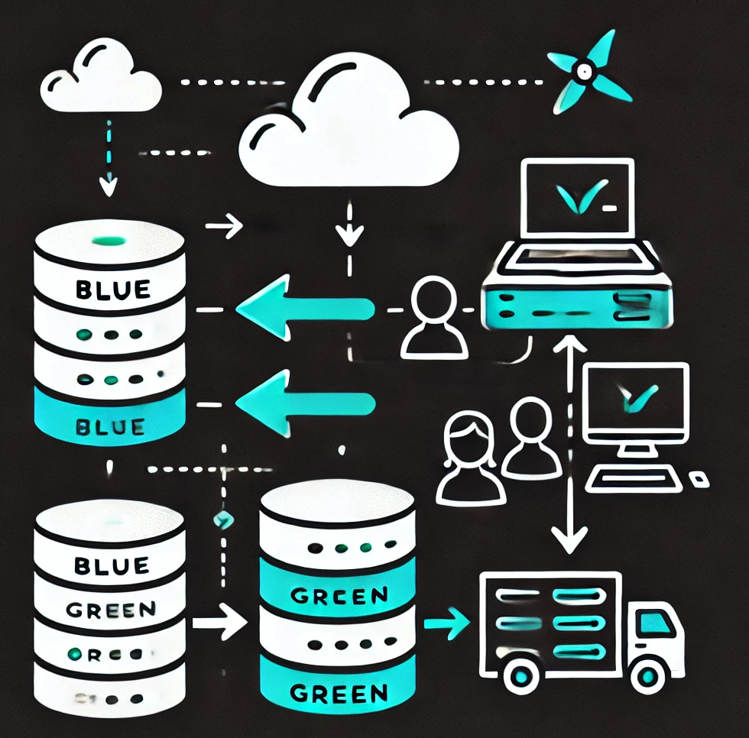


Migration Strategies
Discovery
Design
These four migration strategies, or a combination thereof, are recommended for use during a K8s to NKP cluster migration. The following slides will provide details about each strategy
All strategies can potentially make use of a backup/restore toolset such as Velero (included with NKP Pro & Ultimate product editions). If utilized, this application would need to be deployed to the existing K8s cluster(s).
Big Bang
Blue/Green
Rolling
Canary
Notes:
The four main migration strategies are Big Bang, Blue/Green, Rolling & Canary. An overview of each strategy is provided in the following slides, along with pros/cons of each method.
NOTE: The same backup/restore toolset is required to be present on both the existing K8s cluster and new NKP cluster, if a ‘restore’ of an application to be migrated is required (vs a ‘deploy’ mechanism such as GitOps, Helm or otherwise). NKP Pro & Ultimate editions utilize Velero as their default cluster backup mechanism. Therefore, it is typically recommended to implement the same version of Velero on the existing K8s cluster as used by NKP. However, any toolset that can perform backup & restore capabilities to an acceptable medium for the client (whether that be an AWS S3 bucket, Nutanix Volumes, Nutanix Files, or etc.) may be used.

Slide 11
Migration Strategies Big Bang and Blue/Green
Big Bang
High Level Approach
Backup an existing K8s cluster’s workloads
Shutdown existing K8s cluster
Deploy an NKP cluster
Deploy/restore workloads to NKP cluster
Validate migration on NKP cluster
Tear down existing K8s cluster
Pros
Reduces resource requirements (good for environments with limited capacity)
Least complex migration (all workloads migrated in one fell swoop)
Cons
Migrated workloads will incur an outage
Extended rollback, if required (must power off NKP cluster, power on existing K8s cluster)
Blue/Green
High Level Approach
Deploy an NKP cluster
Backup an existing K8s cluster’s workloads
Scale down workloads on existing K8s cluster that can’t run in parallel w/ new NKP cluster
Deploy/restore workloads to NKP cluster
Cutover LB/DNS to point to NKP cluster
Validate migration on NKP cluster
Tear down existing K8s cluster
Pros
Workload outages limited to those that can’t run in parallel environments
Least complex migration (all workloads migrated in one fell swoop)
Quicker rollback than Big Bang, if necessary
Cons
Migrated workloads that can’t run in parallel will still experience an outage
Requires capacity to run both existing K8s & NKP cluster at same time
Professional Services FY25 Offsite
Notes:
Big Bang is the most simplistic migration strategy to employ. It is typically only recommended for environments where workload outages aren’t a concern and where resource capacity is restricted (not enough system resources to run the existing & NKP cluster at the same time).
Blue/Green is similar in methodology to Big Bang but includes the benefit of a faster rollback procedure, should it prove necessary. For applications that can run in-parallel in both the existing K8s & new NKP cluster, it nearly eliminates downtime, and greatly reduces it for others (compared to Big Bang). This can also be used as an initial ‘validation’ test bed for an application’s ability to run in the new NKP environment before performing a true migration (e.g., by setting up a separate NKP ‘sandbox’ cluster and testing a migration in parallel to its currently running instance on the existing K8s cluster).
The following types of customer resources should be involved in Migration Strategy session(s):
K8s admins
Workload application SMEs
Infrastructure admins

Slide 12
Migration Strategies Rolling and Canary
Rolling
High Level Approach
Deploy an NKP cluster
Backup a workload (& co-reqs) on an existing K8s cluster
Scale down the workload (& co-reqs) on existing K8s cluster if it can’t run in parallel w/ new NKP cluster
Deploy/restore the workload (& co-reqs) to NKP cluster
Cutover LB/DNS to point to workload on NKP cluster
Validate workload on NKP cluster
Repeat previous steps for remaining workloads
Tear down existing K8s cluster
Pros
Similar to ‘Blue/Green’ but with quicker validations and workload outages as it is on an individual scale
Cons
Similar to ‘Blue/Green’ but entirety of workload migration timeframe is extended due to stepped nature of migration
Requires capacity to run both existing K8s & NKP cluster at same time
Canary
High Level Approach
Deploy an NKP cluster
Backup a workload (& co-reqs) on an existing K8s cluster
Deploy/restore the workload (& co-reqs) to NKP cluster
Cutover a percent of traffic to point to workload on NKP cluster
Gradually increase percent of traffic directed to NKP cluster as validation occurs until 100% is reached
Scale down workload on existing K8s cluster
Repeat previous steps for remaining workloads
Tear down existing K8s cluster
Pros
Eliminates outages of workloads
Easiest rollback (reset all traffic to existing K8s cluster)
Cons
Most complex & time-consuming methodology
May not be possible for all workloads
Requires capacity to run both existing K8s & NKP cluster at same time
Professional Services FY25 Offsite
Notes:
Rolling is similar in methodology to Blue/Green, but the migration is done in smaller chunks, allowing for individual validations & rollback, as necessary, before moving along to the next workload (or set of workloads). This also can be used as an initial ‘validation’ test bed for an application’s ability to run in the new NKP environment before performing a true migration.
Canary is a variation that is similar in methodology to Rolling, but even more granular. Instead of completely cutting over a workload from the existing K8s cluster to the new NKP cluster in one step, only a small percentage of traffic is directed to the workload on the NKP cluster and validation can occur while still utilizing the existing K8s platform for most of the work. As validation is confirmed, a greater percentage of the traffic can be gradually shifter over to the NKP cluster and further validated until eventually all traffic is directed to the workload on the NKP cluster. The same process can then be repeated for the remainder of the workloads.
NOTE: This methodology can only be utilized for workloads that can run in parallel on the existing K8s and new NKP clusters without issues.
The following types of customer resources should be involved in Migration Strategy session(s):
K8s admins
Workload application SMEs
Infrastructure admins

Slide 13
Migration Plan Tips

Slide 14
Migration Plan Tips
Migration Plan key factors:
Design for NKP Environment should already exist
Migration scope
Order of Operations
Migration Strategy per Workload
Document Risk
Estimated outage/impact to workload to be migrated
if customer-directed migration strategy varies from what may be considered best-practices
Test Plan per workload
Rollback plan per workload
Document Workloads/clusters/environments not be migrated & why
Additional Plan Considerations:
Persistent Volume considerations
Additional capacity planning
Resource quota requirements (for new NKP cluster)
Network changes (IP addressing, firewall rules, etc.)
LB & DNS cutovers
CI/CD, GitOps considerations
Other application dependencies (DB changes, cache servers, etc.)
Identify & plan for application downtimes, where applicable
Application change/outage windows
Version Compatibility changes (e.g.: K8s, dependent apps.)
Notes:
The Migration Plan should flow in the order the migrations should occur – e.g.: by environment, then within each environment by cluster, and within each cluster the workload migration order. Best practices dictate that lower environments should be migrated prior to higher environments to adjust & improve the plan as needed. This will help refine the plan, reduce risk & outage durations for production/enterprise-level workloads. If certain environments, clusters, and/or workloads within a cluster are not to be migrated, they should be documented with customer provided reasoning to insure they were accounted for in the migration plans.
Be sure to include/address these considerations in the migration plan, where applicable. This is not an exhaustive list but a ‘best effort’ attempt to cover the likely factors to consider – depending on the specific workload to be migrated, there could be other unforeseen factors to address in its migration strategy. It is incumbent to stress to the workload application owners during the migration design that they are responsible for pointing out all the factors that can impact their application’s migration, as they are the SMEs for it.

Slide 15
Migration Plan Execution

Slide 16
Migration Plan Execution
1
Review
Review and confirm the plan with all relevant parties
Schedule
Determine the migration schedule.
Notify all involved/impacted parties
2
3
Execute
Address and revise plan based on results
Document & Apply ‘lessons learned’ to future migrations
Adjust migration schedule as necessary
Notes:
Execution of the Migration Plan should not be considered a rigid process. It is likely, despite best intentions and thorough planning process, that some necessary aspects or impacts caused by a migration could be missed or unaccounted for. That is why it is highly recommended to be performed in an order that is least impactful to the user community, so that lessons learned can be applied & improved upon for the remaining migration effort to occur.

Slide 17
Test Plan Tips
Confirm successful workload migration:
K8s objects exist & are in an operational state (pods, services, ingress, etc.)
Application validation test plan passes
User UI testing
Use case testing
DB/stored data testing
Application logs OK
Internal Use Only
Notes:
This slide covers (at a high level), the type of validations at the application level that should occur to confirm the restored workloads are operating properly on NKP

Slide 18
Test & Validation
Discovery
Design
Discovery
Design
Validate
Test Plan to validate migration:
K8s objects exist & are in an operational state (pods, services, ingress, etc.)
Application validation test plan passes
User UI testing
Use case testing
DB/stored data testing
Application logs OK
Deploy/Migrate
Validate
Deploy/Migrate
Notes:
This slide covers (at a high level), the type of validations at the application level that should occur to confirm the restored workloads are operating properly on NKP
A test plan should be documented as part of the Design. It should then be used as part of the deployment or migration to VALIDATE a successful migration.

Slide 19
NKE to NKP Migrations
Notes:
While the migrations strategies and design planning will apply to any K8s platform migration over to NKP, it is anticipated that most of these efforts will be NKE to NKP related, as NKE becomes EOL and we actively encourage our customer base to convert over to NKP.
Therefore, these next series of slides will cover the setup & config of Velero on both NKE and NKP (which will be utilized for performing the migration of workloads between the platforms), as well as a few simple use cases for stateless & stateful migrations using both Nutanix Volumes & Files.
NOTE: Be sure to refer to the “NKE->NKP migration workflow using Velero and Nutanix objects” guide for full details, disclaimers, limitations & important considerations on performing workload migrations (link to document included in Conclusion section of this presentation).

Slide 20
NKE 2 NKP Migration Example - Overview
Install Velero on NKE
Deploy/Reconfigure Velero on NKP
Migrate Stateless Workloads
Backup stateless workloads on NKE
Restore backup on NKP
Migrate Stateful Workload
Nutanix Volumes
Backup stateful workload on NKE
Restore stateful workload on NKP
Nutanix Files
Backup stateful workload on NKE
Backup stateful workload on NKP
Notes:
Velero will be used for workload backups in NKE, then restores on NKP. Unless the customer is already using Velero for backups, it will likely need to be installed on the NKE cluster.
Depending on the NKP product edition, Velero may or may not be available for deployment via the NKP UI
NKP Starter does not come with Velero, so it would need to be installed using the K8s API, kubectl
NKP Pro & Ultimate come packaged with Velero, so it can be enabled (if not currently in use) from the NKP UI – it will also need to be configured for the backup storage location, even if already enabled, however
Details on performing the following example use cases will be provided:
Migration of stateless workloads existing in a specific namespace
Migration of a stateful workload existing in a specific namespace via Nutanix Volumes
Migration of a stateful workload existing in a specific namespace via Nutanix Files

Slide 21
Related Documents
This presentation was based heavily on the following document:
NKE to NKP Migration Workflow (using Velero & Nutanix Objects):
Developed for NKE to NKP Migrations by our friends in Cloud Native R&D:
Arvind Bhoj
Christophe Jauffret
Same methodology applies to other K8s clusters/platforms as well
Rancher, Tanzu (VMware), Mirantis, etc.
Velero & NKP Backup/Restore Related Links:
Velero Product Site
NKP: Velero Configuration
NKP: Cluster Application & Persistent Volumes Backup
Internal Use Only
Notes:
Let’s give a shout out to our Cloud Native R&D folks! They invested blood, sweat & tears into providing & validating a blueprint for NKE migrations over to NKP, and have successfully performed multiple migrations with actual customers in our EMEA region.
As mentioned, while their blueprint is based on NKE to NKP migrations, the same methodology can apply to ANY K8s platform (native or otherwise) that needs to be migrated to NKP!
Velero was utilized for migration validation by R&D and is the default provided backup solution included with NKP

Slide 22


Arvind Bhoj
Christophe Jauffret
Sr. Solutions Architect
Principal Solutions Architect
NKE->NKP Migration Workflow Using Velero and Nutanix Objects
Co-Authors
Notes:
Arvind Bhoj – co-author, NKE->NKP migration workflow using Velero and Nutanix objects
Christophe Jauffret – co-author, NKE->NKP migration workflow using Velero and Nutanix objects

Slide 23

Feedback Survey

Slide 24
Thank You
Have you submitted your survey?

